Slide 1
Graduate Artificial Intelligence CS 640 Hidden Markov Models
Jeffrey Considine
jconsidi@bu.edu

Slide 2
Plan for Today
What are hidden Markov models?
Problems based on hidden Markov models
Evaluation algorithms
Recognition algorithms

Slide 3
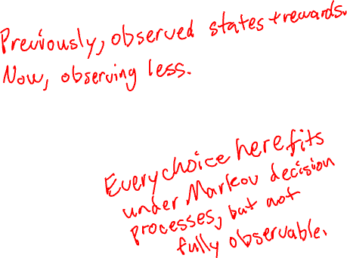
Properties of An Environment
States: finite or infinite?
States: visible or hidden?
If hidden, what do we observe?
Transitions: deterministic or probabilistic?
Rewards: deterministic or probabilistic?
If probabilistic, is average enough?

Slide 4
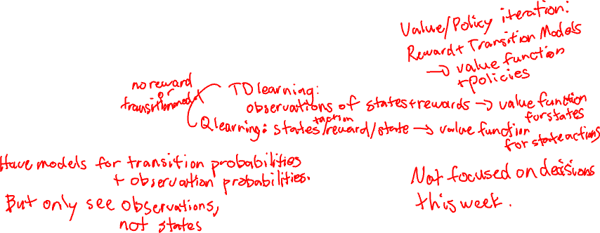
Common Models of Environment
Finite state machine
Finite visible states, deterministic transitions and outputs.
Fully-observable Markov model
Visible states, probabilistic transitions and rewards
Hidden Markov model
Hidden states, probabilistic observations, transitions and rewards

Slide 5
Markov Models
Always know the current state.
So, we can predict behavior if we know the reward and transition models.

Slide 6
Hidden Markov Models
True state is unknown.
Observable outputs let us make inferences about true states.
Usually, cannot determine true state with 100% certainty.
Observable output is usually probabilistic.
Even if deterministic, other states might have the same output.
Otherwise, a unique output will identify the true state.

Slide 7
Weather Comparison
Markov Model
Hidden Markov Model
Track the entire state of the planet…
Know the state everywhere!
Just look at the Boston weather report
Can make some inferences about state around New York, but fuzzy.

Slide 8
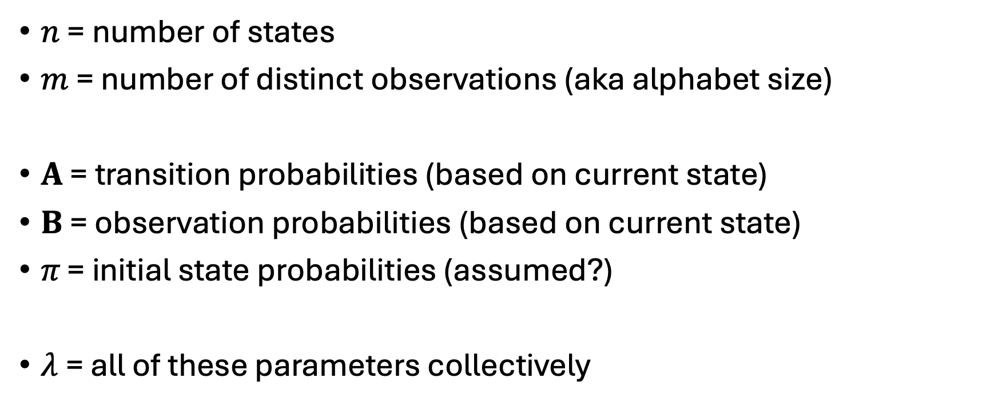
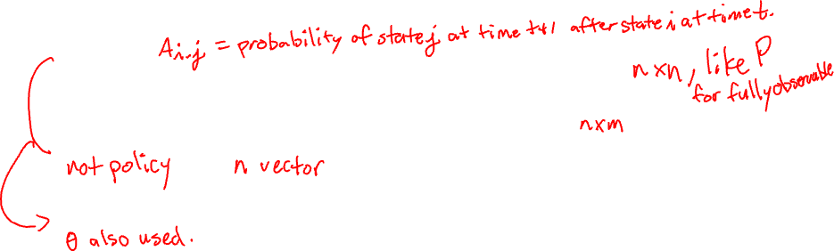
Formalizing Hidden Markov Models
$n$ = number of states
$m$ = number of distinct observations (aka alphabet size)
$A$ = transition probabilities (based on current state)
$B$ = observation probabilities (based on current state)
$π\text{ = }\text{initial} \text{state} \text{probabilities}$ (assumed?)
$λ$= all of these parameters collectively

Slide 9


Formalizing Hidden Markov Models (cont)
$O=[o_{0},o_{1},…,o_{T−1}]$ observations (known)
$Q=[q_{0},q_{1},…, q_{T−1}]$ true states (unknown)

Slide 10
Any Questions?
Moving On
???
What are hidden Markov models?
Problems based on hidden Markov models
Evaluation algorithms
Recognition algorithms

Slide 11
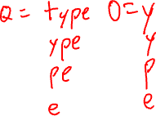
Hidden Markov Models Match Real Problems Better?
Wake up in the morning, look out the window to guess time?
Given mistyped word, what was the intended word?
Given voice sample, what was said?

Slide 12
Questions with Hidden Markov Models
Given a hidden Markov model and its output observations,
What is the current state?
What were the past states?
What will the next / future outputs be?

Slide 13
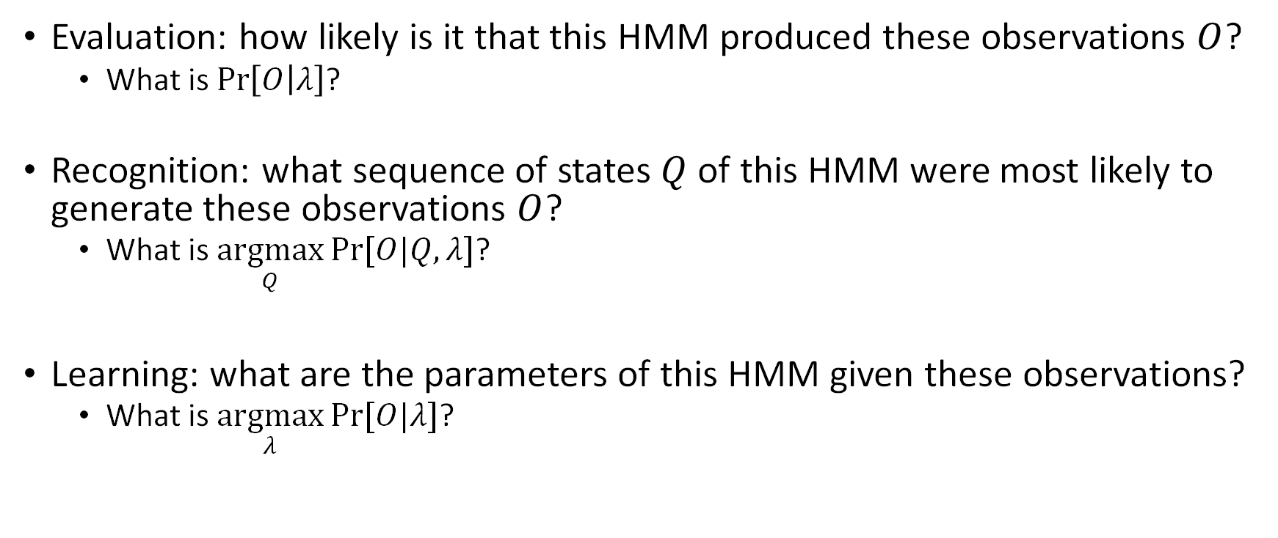
Standard Problems for HMMs
Evaluation: how likely is it that this HMM produced these observations $O$?
What is $\operatorname{Pr}\left[O | λ\right]$?
Recognition: what sequence of states $Q$ of this HMM were most likely to generate these observations $O$?
What is $\underset{Q}{argmax}{Pr⁡[O|Q,λ]}$?
Learning: what are the parameters of this HMM given these observations?
What is $\underset{λ}{argmax}{Pr⁡[O|λ]}$?

Slide 14
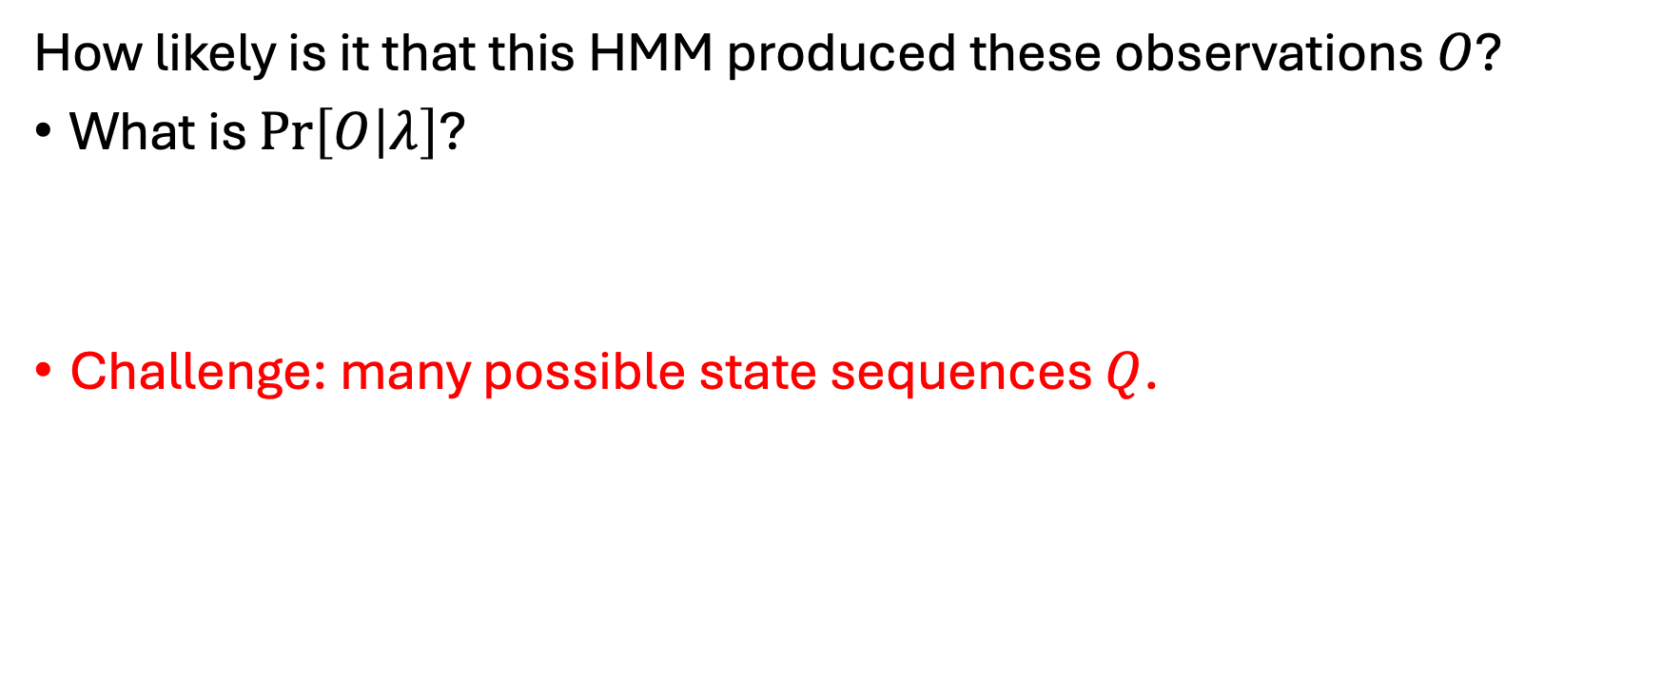

Evaluation Problem for HMMs
How likely is it that this HMM produced these observations $O$?
What is $\operatorname{Pr}\left[O | λ\right]$?
Challenge: many possible state sequences $Q$.

Slide 15
Examples of Evaluation Problems
???

Slide 16
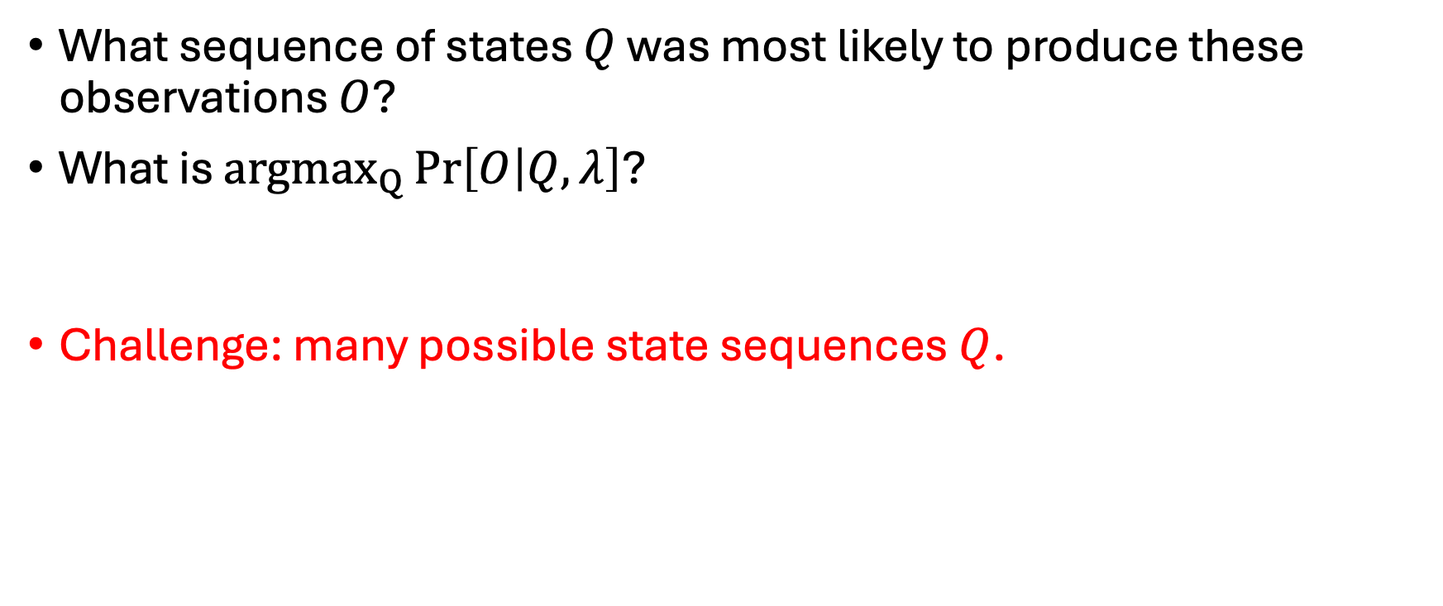
Recognition Problem for HMMs
What sequence of states $Q$ was most likely to produce these observations $O$?
What is ${argmax}_{Q}{\operatorname{Pr}\left[O | Q,λ\right]}$?
Challenge: many possible state sequences $Q$.

Slide 17
Examples of Recognition Problems
???

Slide 18
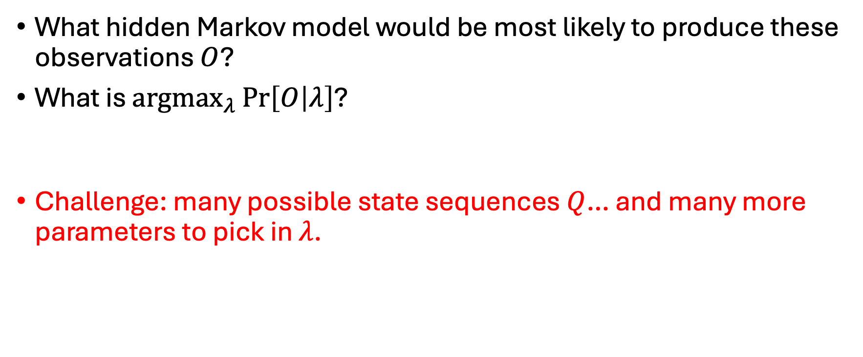
Learning Problem for HMMs
What hidden Markov model would be most likely to produce these observations $O$?
What is ${argmax}_{λ}{\operatorname{Pr}\left[O | λ\right]}$?
Challenge: many possible state sequences $Q$… and many more parameters to pick in $λ$.

Slide 19
Examples of Learning Problems
???

Slide 20
Prediction Problems for HMMs
Not in the standard problem list, but…

Slide 21
Any Questions?
Moving On
???
What are hidden Markov models?
Problems based on hidden Markov models
Evaluation algorithms
Recognition algorithms

Slide 22
Bayes’ Rule

Slide 23
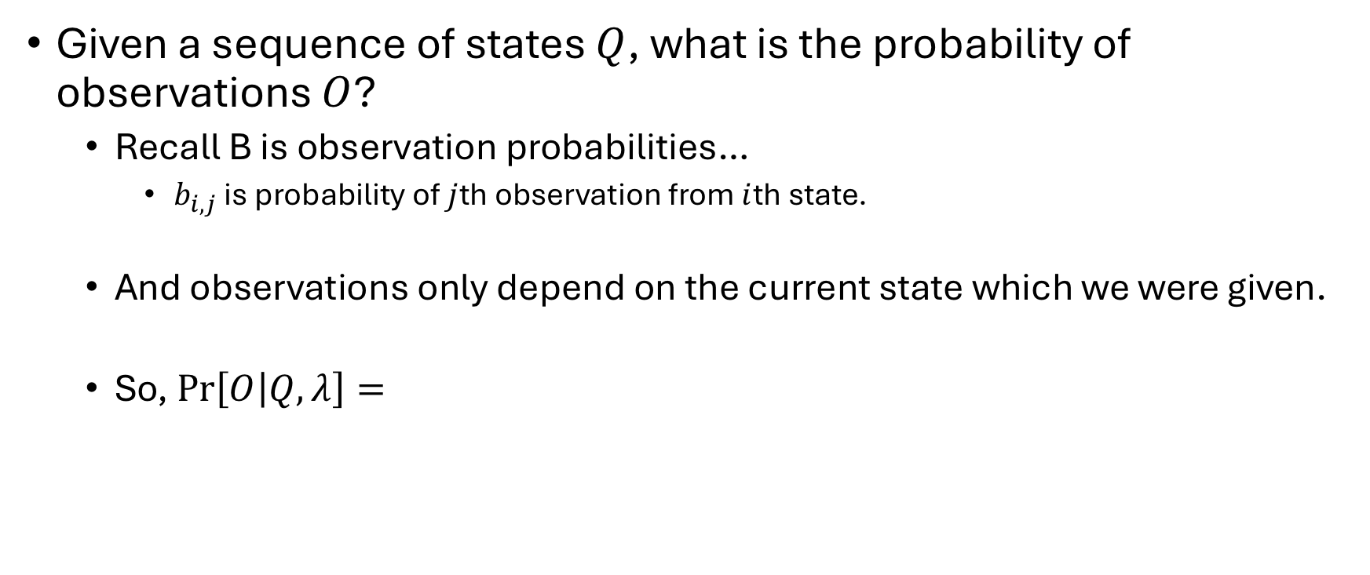

Simplified Evaluation Problem
Given a sequence of states $Q$, what is the probability of observations $O$?
Recall B is observation probabilities…
$b_{i,j}$ is probability of $j$th observation from $i$th state.
And observations only depend on the current state which we were given.
So, $\operatorname{Pr}\left[O | Q,λ\right]=$

Slide 24

Why is the full Evaluation Problem Harder?
???

Slide 25

Rewriting an Evaluation Problem as an MRP

Slide 26
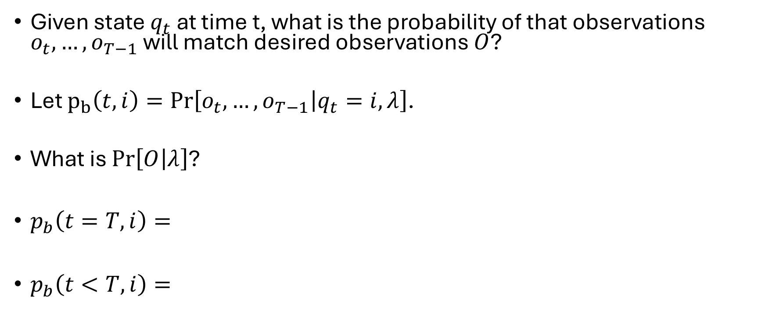

Backward Algorithm
Given state $q_{t}$ at time t, what is the probability of that observations $o_{t},…, o_{T−1}$ will match desired observations $O$?
Let $p_{b}\left(t, i\right)=\operatorname{Pr}\left[o_{t},…, o_{T−1} | q_{t}=i,λ\right]$.
What is $\operatorname{Pr}\left[O | λ\right]$?
$p_{b}\left(t=T,i\right)=$
$p_{b}\left(t<T, i\right)=$

Slide 27
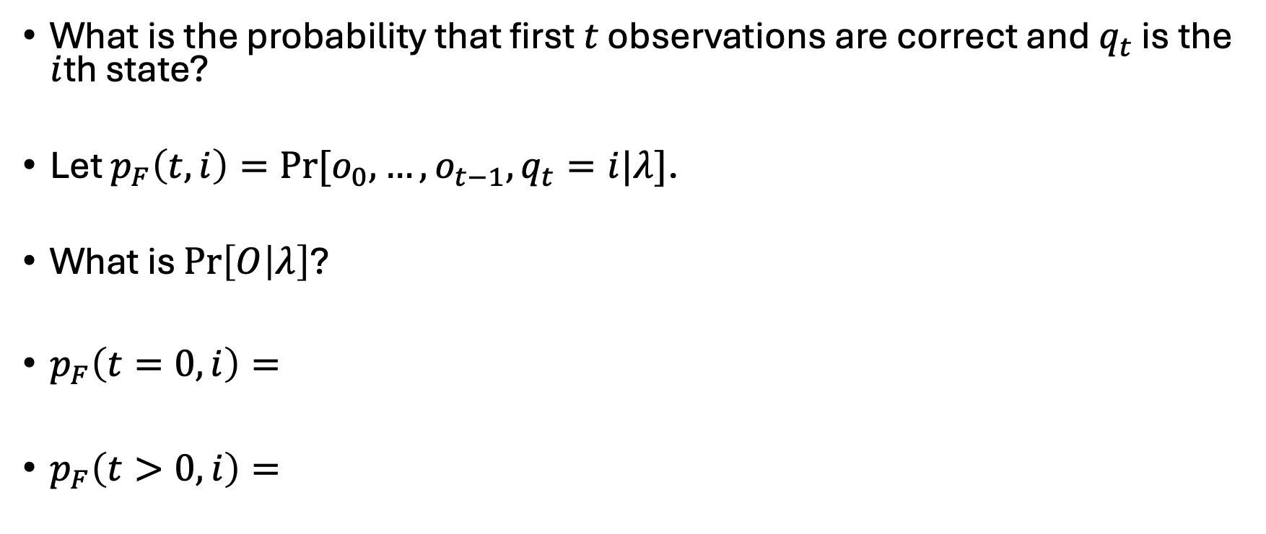
Forward Algorithm
What is the probability that first $t$ observations are correct and $q_{t}$ is the $i$th state?
Let $p_{F}\left(t, i\right)=Pr⁡[o_{0},…,o_{t−1},q_{t}=i|λ]$.
What is $\operatorname{Pr}\left[O | λ\right]$?
$p_{F}\left(t=0,i\right)=$
$p_{F}\left(t>0,i\right)=$

Slide 28
Any Questions?
Moving On
???
What are hidden Markov models?
Problems based on hidden Markov models
Evaluation algorithms
Recognition algorithms

Slide 29
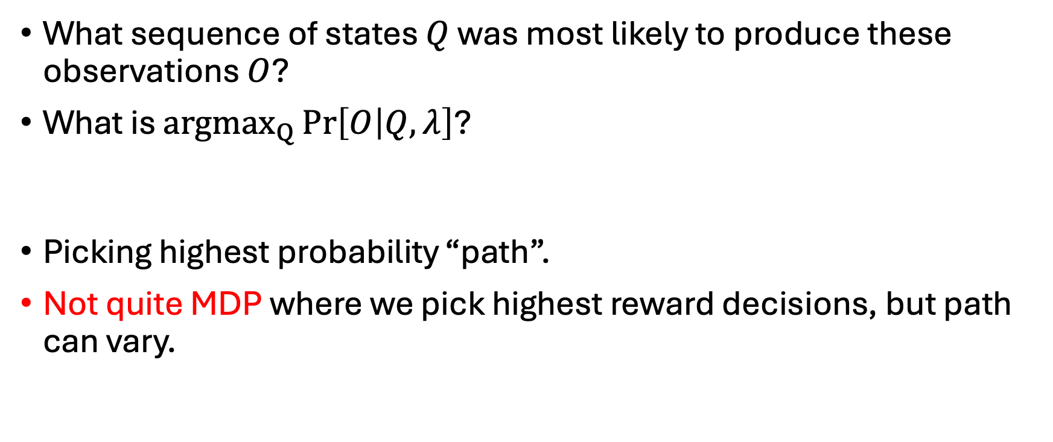
Learning Problem
What sequence of states $Q$ was most likely to produce these observations $O$?
What is ${argmax}_{Q}{\operatorname{Pr}\left[O | Q,λ\right]}$?
Picking highest probability “path”.
Not quite MDP where we pick highest reward decisions, but path can vary.

Slide 30
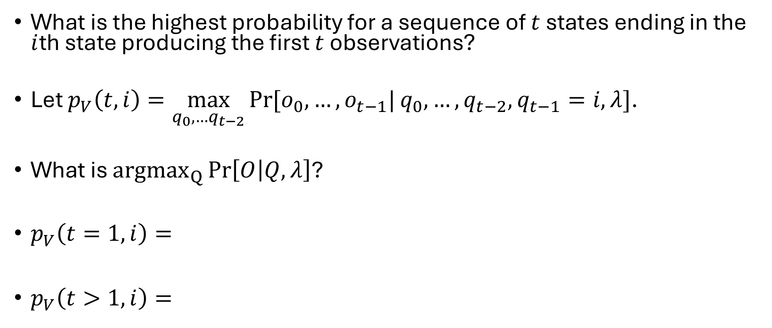
Viterbi Algorithm
What is the highest probability for a sequence of $t$ states ending in the $i$th state producing the first $t$ observations?
Let $p_{V}\left(t,i\right)=\max_{q_{0},…q_{t−2}}{Pr⁡[o_{0},…,o_{t−1}|}q_{0},…,{q_{t−2},q}_{t−1}=i,λ]$.
What is ${argmax}_{Q}{\operatorname{Pr}\left[O | Q,λ\right]}$?
$p_{V}\left(t=1,i\right)=$
$p_{V}\left(t>1,i\right)=$

Slide 31
Any Questions?
Next Time
???
How do we learn the parameters of a hidden Markov model?

